Slide 1
Theorie Bioinformatica
Faster, better, stronger
Bioinformatics and functional genomics (3e) – Jonathan Pevsner (Wiley Blackwell)

Slide 2
De stof komt uit de college presentaties en Jonathan Pevsner "Bioinformatics and Functional Genomics"
(Wiley Blackwell; 3e editie) en een aantal extra papers
(deze worden expliciet in de betrokken colleges genoemd, en zijn te vinden onder "achtergrond").
College | Onderwerp | Hoofdstuk | Pagina's | Opmerkingen
1 | Recap Bioinf 1 | 3-4 | Zie Bioinf1 | Deze stof word t bekend verondersteld!
2 | Next Generation Sequencing | 9 | 377-423 | Niet de source code in je hoofd stampen!
3 | RNASeq | 11 | 479-515,519-528 | Niet de letterlijke R code, niet fig 11.17, 11.18, 11.19, 11.20
4 | Multiple Sequence Alignment | 6 | 205-217, 221-223 | Niet Box 6.3
8/9 | Assembly | 9/15 | 395-398,730-736 | Bestudeer ook de Powerpoint extra!
10 | The Burrough-Wheeler transform for mapping reads | 5
3 | Phylogeny | 7 | 245-289 | Niet Box 7.2,

Slide 3
Presentation content
Chapter 9: pg. 388-423
http://pevsnerlab.kennedykrieger.org/php/powerpoints

Slide 4
NGS in 11 steps
1. Experimental design and sample preparation
2. From generating sequence Data to FASTQ
3. Genome Assembly
4. Sequence alignment
5. The SAM/BAM format and SAMtools
6. Variant calling: Single nucleotide variants and indels
7. Variant Calling: Structural Variants
8. Summarizing Variation: the VCF Format and VCFtools
9. Visualizing and Tabulating NGS-data
10. Interpreting the biological significance of variants
11. Storing Data in Repositories

Slide 5
Broad clinical workflow for WGS of patients
Overview of the process
Motivation to sequence a patient’s genome
Oversight, IRB, and informed consent
Time frame and costs
Inclusion criteria: identifying appropriate patients
Exclusion criteria: whose genome not to sequence
Data acquisition
Informed consent, blood, and saliva
Obtaining whole genome sequence: the technology
The deliverables: catalogs of genetic variants
Data interpretation
Identifying candidate genes
Validation

Slide 6
1. Experimental design and sample preparation
1. Select proband(s)
2. Purify genomic DNA
3. Generate paired-end library
4. Design capture beads (e.g. Agilent SureSelect)
5. Hybridize in solution
6. Elute enriched genomic DNA
7. Amplify
8. Next-generation sequencing
9. Align sequence to a human genome reference
10. Determine coverage (e.g. 30-fold)
11. Identify variants: SNPs, indels (distinguish true variants from sequencing errors)
12. Prioritize variants
13. Validate variants
optional; used for whole exome sequencing
Notes:
6

Slide 7
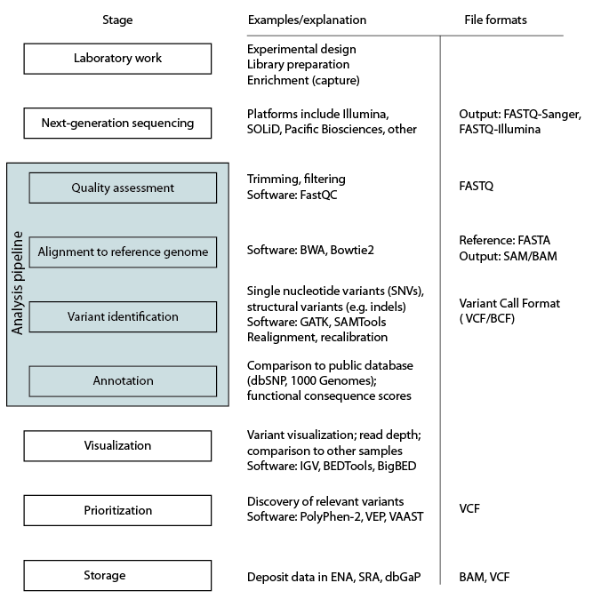
Next-generation sequencing workflow

Slide 8
Genome Analysis Toolkit (GATK) workflow
Phase I: data processing

Slide 9
Genome Analysis Toolkit (GATK) workflow
Phase II: variant discovery and genotyping

Slide 10
Genome Analysis Toolkit (GATK) workflow
Phase III: integrative analysis

Slide 11
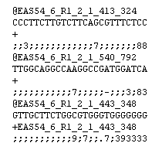
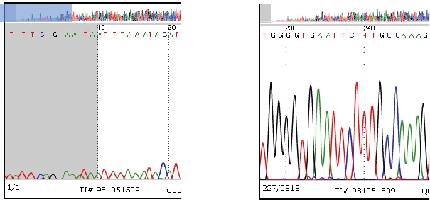
2. From generating sequence Data to FASTQ
The FASTQ format stores DNA sequence data as well as associated Phred quality scores of each base.
DNA read
Base quality score
Notes:
11

Slide 12
FASTQ quality scores use ASCII characters
…relating quality scores (e.g. Q30 for 1 in 10⁻³ error rate) to a compact, one character symbol
You do not need to learn the one character symbols, but you should know the importance of base quality scores in sequence analysis.

Slide 13

FASTQ format: Phred scores define quality
The FASTQ format stores DNA sequence data as well as associated Phred quality scores of each base.
Phred quality score | Probability of incorrect base call | Base call accuracy
10 | 1 in 10 | 90%
20 | 1 in 100 | 99%
30 | 1 in 1,000 | 99.9%
40 | 1 in 10,000 | 99.99%
50 | 1 in 100,000 | 99.999%
Notes:
13

Slide 14


FASTQ format: Phred scores define quality
Phred quality scores of each base are usually defined:
There have been alternative base quality definitions:
Notes:
14

Slide 15
99% of sequence analysis is on the command line
(Linux or Mac)
Most next-generation sequence (NGS) analysis is done on the command line. Command line software (using Linux or the Unix-like platform on a Mac terminal) is capable of handling the data analysis tasks, and most NGS software is written for the Unix operating system.
Many people access a Linux (or related Unix) environment while working on a PC or Mac. For example, you can do “cloud computing” in which you pay someone (Amazon, Google, Microsoft) to access their servers. Johns Hopkins has Linux servers you can access (https://www.marcc.jhu.edu).
The next three slides provide examples of command-line tools to look at FASTQ-formatted files.

Slide 16
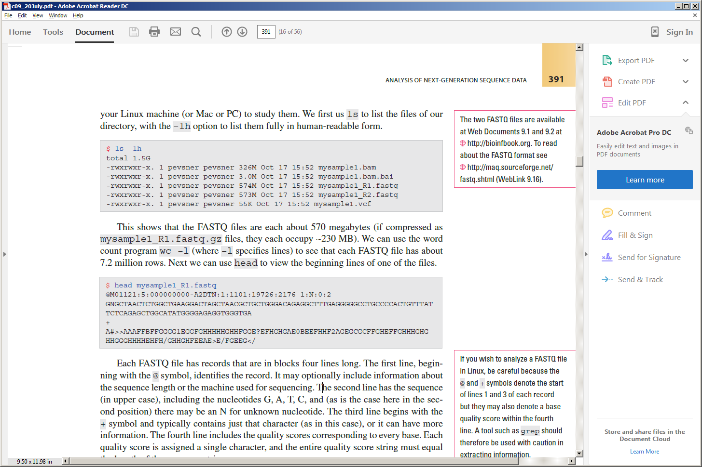
99% of sequence analysis is on the command line
(Linux or Mac)
The ls –lh command lists the files in a directory.
Here there are two FASTQ files, BAM, BAM index, and VCF.
The head command displays the first few lines of a file. Here the first four rows of a FASTQ file are shown.
B&FG 3e
Page 391

Slide 17
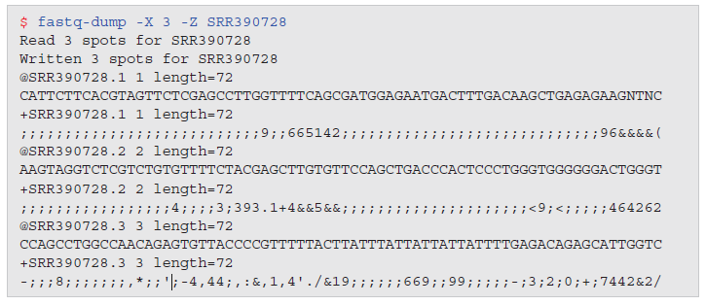

SRA toolkit:
fastq-dump to obtain FASTQ formatted data
NCBI offers the SRA Toolkit to manipulate sequence data. The fastq-dump command can pull FASTQ-formatted data from an accession number (such as SRR390728).
B&FG 3e
Page 393

Slide 18
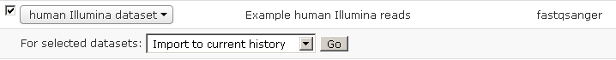
FASTQ format: where to learn more
FASTQ project page http://maq.sourceforge.net/fastq.shtml
You can look at FASTQ files in Galaxy > Shared data > Data libraries > Sample NGS Datasets > Human Illumina dataset. Check the box, click Go, and the data are entered in Galaxy (see the Analyze Data tab where you usually begin a Galaxy session).
Galaxy also offers helpful videocasts about manipulating FASTQ files.
Notes:
18

Slide 19
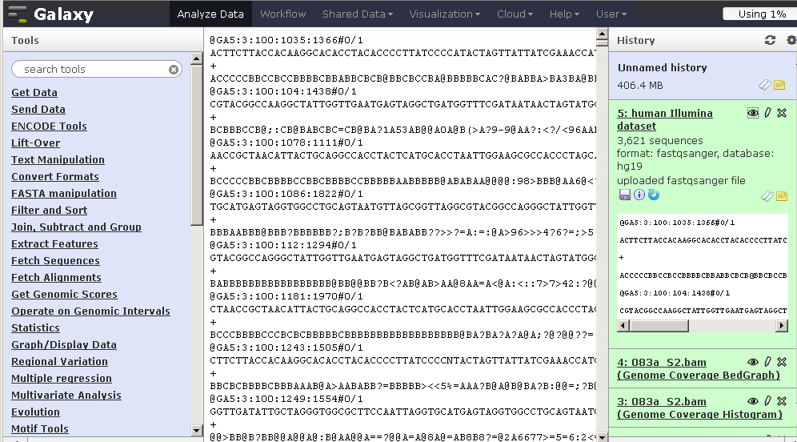
Example of FASTQ data in Galaxy

Slide 20
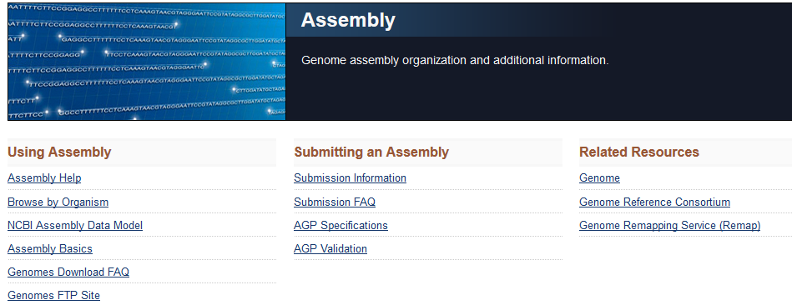
3. Genome Assembly
Genome assembly is the process of converting short reads into a detailed set of sequences corresponding to the chromosome(s) of an organism.
To learn more about assembly visit
http://www.ncbi.nlm.nih.gov/assembly/
http://www.ncbi.nlm.nih.gov/assembly/basics/

Slide 21
Genome assembly: relevance
Genome assembly is needed when a genome is first sequenced. We can relate reads to chromosomes.
For the human genome, the assembly is “frozen” as a snapshot every few years. The current assembly is GRCh38. (GRC refers to Genome Reference Consortium at http://www.ncbi.nlm.nih.gov/projects/genome/assembly/grc/)
For most human genome work we do not need to do “de novo” (from anew) assembly. Instead, we map reads to a reference genome—one that is already assembled.
Genome assembly is a crucial behind-the-scenes part of calling human genome (or other) variants.

Slide 22
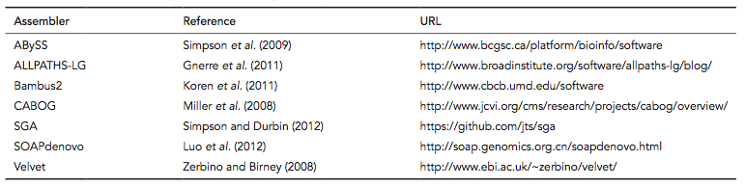
Software for genome assembly
B&FG 3e
Table 9-2
Page 395
We’ll use Velvet for assembly in Chapter 15.

Slide 23
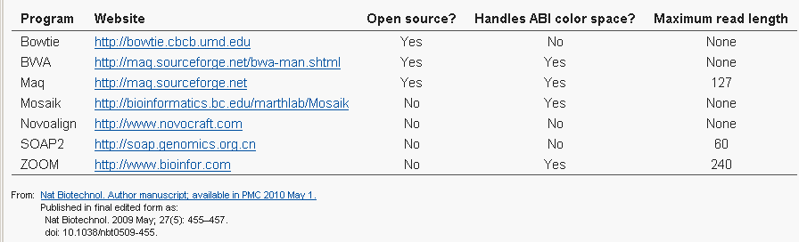
4. Sequence alignment
Recent software tools allow the mapping (alignment) of millions or billions of short reads to a reference genome.
--For the human genome, this would take thousands of hours using BLAST.
--Reads may come from regions of repetitive DNA (exacerbated by sequencing errors)

Slide 24
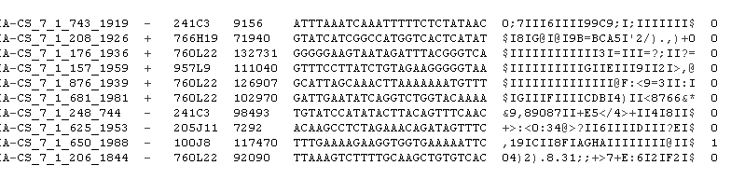
Alignment to a reference genome: example of short-read alignment (Bowtie) results
References to which
reads match
reads
quality scores

Slide 25
BWA: a popular short-read aligner
Aligns short reads (<200 base pairs) to a reference genome
Fast, accurate
Learn more at http://bio-bwa.sourceforge.net/
Command-line software for the Linux environment (like essentially all NGS tools)
Try it in a web-accessible version! Go to Galaxy > see list of tools on left sidebar > NGS Toolbox beta > NGS: Mapping > Map with BWA for Illumina
Notes:
25

Slide 26
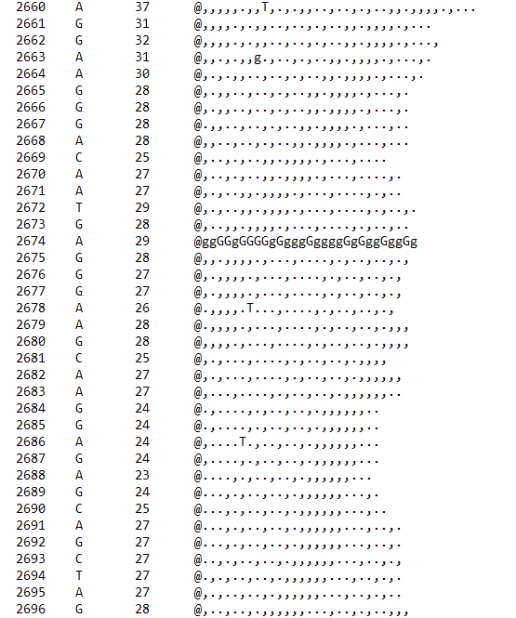
Reference sequence
(5 Mb, fasta format)
Read depth
Reference sequence A;
Sample has G 29 times
. and , denote agreement with reference on top, bottom strands
MAQ analysis

Slide 27
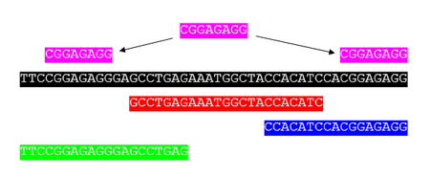
Mapping, alignment, assembly??
Read mapping is the process to align the reads on a reference genomes (SOAP, BWA, Bowtie)
Sequence assembly refers to aligning and merging fragments from a longer DNA sequence in order
to reconstruct the original sequence. (Spades, SOAP-denovo)
Sequence alignment is a way of arranging the sequences of DNA, RNA,
or protein to identify regions of similarity that may be a consequence of functional, structural,
or evolutionary relationships between the sequences
(ClustalW)

Slide 28
NGS in 11 steps
1. Experimental design and sample preparation
2. From generating sequence Data to FASTQ
3. Genome Assembly
4. Sequence alignment
5. The SAM/BAM format and SAMtools
6. Variant calling: Single nucleotide variants and indels
7. Variant Calling: Structural Variants
8. Summarizing Variation: the VCF Format and VCFtools
9. Visualizing and Tabulating NGS-data
10. Interpreting the biological significance of variants
11. Storing Data in Repositories

Slide 29
5. The SAM/BAM format and SAMtools
There are many tools to view SAM/BAM files. A popular software package (SAMTools, used in Linux) includes tview visualization of reads from a BAM file
B&FG 3e
Fig.9-14
Page 404

Slide 30
SAM and BAM??
Sequence Alignment Map (SAM) is a text-based format originally for storing biological sequences aligned to a reference sequence.
Binary Alignment Map (BAM) is the binary form of a SAM file.

Slide 31
Sequence alignment/map format (SAM) and BAM
SAM is a common format having sequence reads and their alignment to a reference genome.
Aligned BAM files are available at repositories (Sequence Read Archive at NCBI, ENA at Ensembl)
SAMTools is a software package commonly used to analyze SAM/BAM files.
Visit http://samtools.sourceforge.net/
Notes:
31

Slide 32
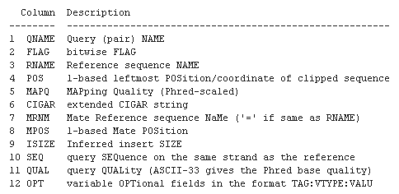
BWA and other aligners produce output in the SAM format

Slide 33
Anatomy of a Sequence Alignment/Map (SAM) file
B&FG 3e
Fig.9-13
Page 403

Slide 34
Anatomy of a Sequence Alignment/Map (SAM) file
In this example we’ll look at a file called 030c_s7.bam. It is a BAM file (the binary of a SAM). Most software manipulates BAM files rather than SAM.
The $ symbol indicates a command prompt in Unix
The | symbol (called “pipe”) indicates to send the results to another program—in this case to the utility called less that displays one page at a time on your terminal.
Type samtools to run that program, and it includes a series of tools (such as view) to accomplish particular tasks—here, to view the contents of a file
B&FG 3e
Fig.9-13
Page 403

Slide 35
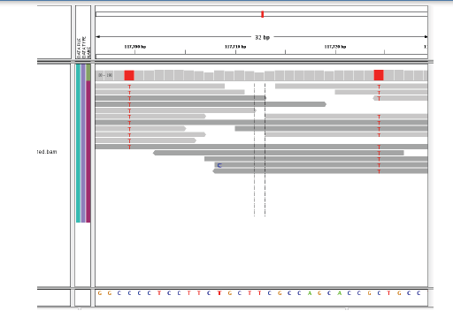
Next-generation sequence data: visualizing of short reads aligned to a reference genome (IGV)
reads
variant
reference genome

Slide 36
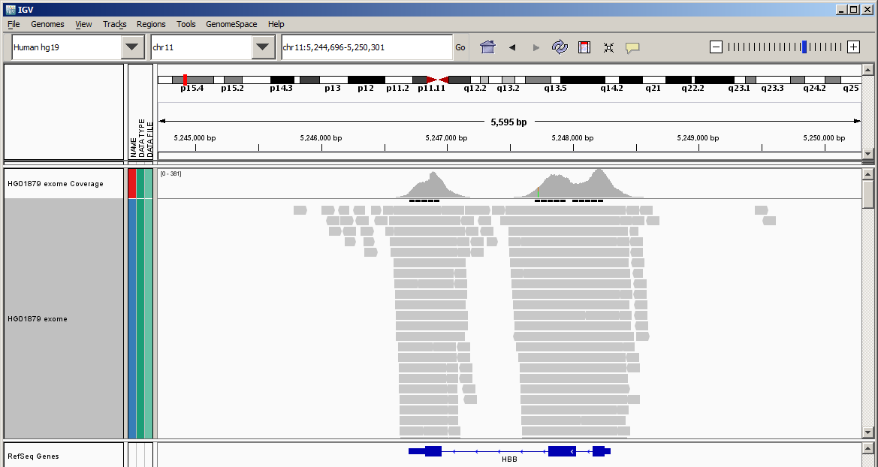
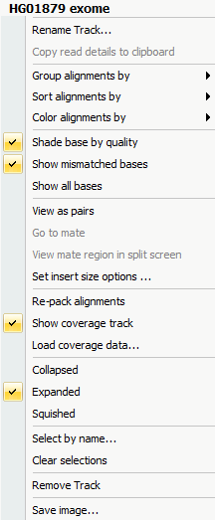
IGV visualization of reads from a BAM file
Explore this gene. Zoom in. Click the left sidebar to change the display to squished. Color the alignments. Find variants.

Slide 37
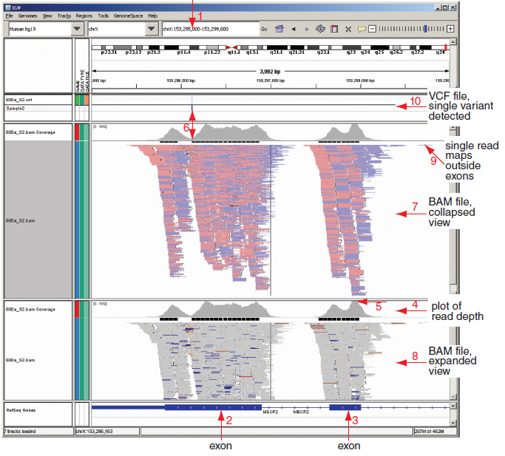
Integrative Genomics Viewer (IGV):
display of a BAM file (at two resolutions) and a VCF
B&FG 3e
Fig.9-15
Page 407

Slide 38
Reads (FASTQ format) can be mapped to a reference genome using software tools such as BWA (cont.)
There are dozens of aligners to choose from.
Each aligner has many parameters you can choose.
BWA is a popular aligner. It stands for “Burroughs-Wheeler Aligner” referring to the algorithmic approach. See http://bio-bwa.sourceforge.net
Considerations are speed and sensitivity.
For all software we measure error rates: using some gold standard we define true positive (TP) and true negative (TN) results, and we then define sensitivity and specificity.

Slide 39
NGS in 11 steps
1. Experimental design and sample preparation
2. From generating sequence Data to FASTQ
3. Genome Assembly
4. Sequence alignment
5. The SAM/BAM format and SAMtools
6. Variant calling: Single nucleotide variants and indels
7. Variant Calling: Structural Variants
8. Summarizing Variation: the VCF Format and VCFtools
9. Visualizing and Tabulating NGS-data
10. Interpreting the biological significance of variants
11. Storing Data in Repositories

Slide 40
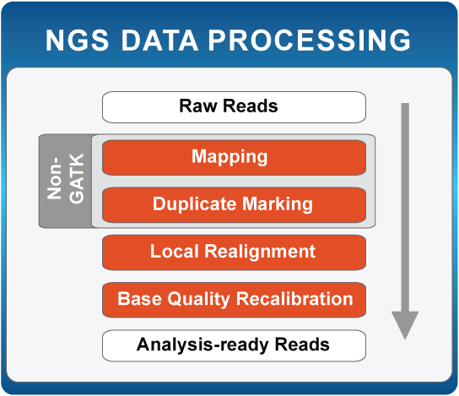
6. Variant calling: Single nucleotide variants and indels
Popular suite of tools used for genotyping and variant discovery
http://www.broadinstitute.org/gatk/
Notes:
40

Slide 41
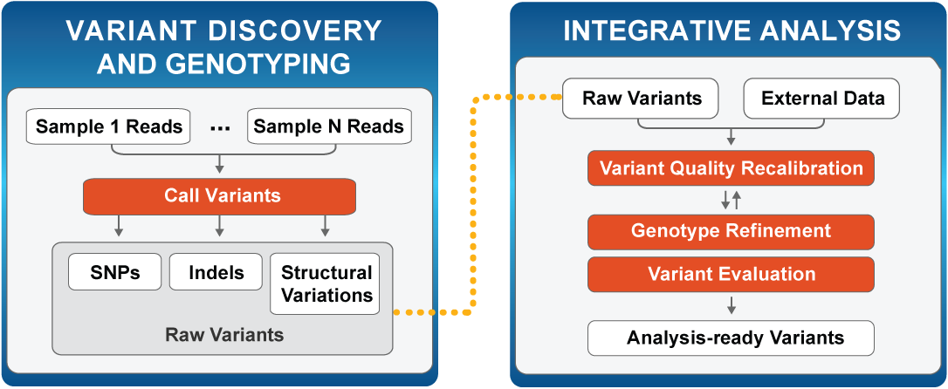
Genotyping with Genome Analysis Toolkit (GATK)
http://www.broadinstitute.org/gatk/
Notes:
41

Slide 42
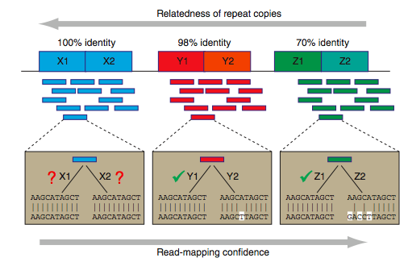
As repeat regions share lower identity,
read mapping gains higher confidence
Relatedness of repeat copies
Read mapping confidence
Source: PMID 22124482

Slide 43
There is ambiguity mapping a read with a mismatch versus a deletion
B&FG 3e
Fig.9-12
Page 401

Slide 44
7. Variant Calling: Structural Variants
Read depth
SV class
Assembly
Read pair
Split end
Deletion
Novel sequence insertion
Mobile-element insertion
Inversion
Interspersed duplication
Tandem duplication
Source: PMID 21358748

Slide 45
Categories of structural variation (SV): deletions
Read depth
SV class
Assembly
Read pair
Split end
Deletion
Source: PMID 21358748

Slide 46
Categories of structural variation (SV): insertions
Read depth
SV class
Assembly
Read pair
Split end
Novel sequence insertion
not applicable
Mobile-element insertion
not applicable
Source: PMID 21358748

Slide 47
Categories of structural variation (SV): inversions
Read depth
SV class
Assembly
Read pair
Split end
Inversion
not applicable
Source: PMID 21358748

Slide 48
Categories of structural variation (SV): duplications
Read depth
SV class
Assembly
Read pair
Split end
Interspersed duplication
Tandem duplication
Source: PMID 21358748

Slide 49
NGS in 11 steps
1. Experimental design and sample preparation
2. From generating sequence Data to FASTQ
3. Genome Assembly
4. Sequence alignment
5. The SAM/BAM format and SAMtools
6. Variant calling: Single nucleotide variants and indels
7. Variant Calling: Structural Variants
8. Summarizing Variation: the VCF Format and VCFtools
9. Visualizing and Tabulating NGS-data
10. Interpreting the biological significance of variants
11. Storing Data in Repositories

Slide 50
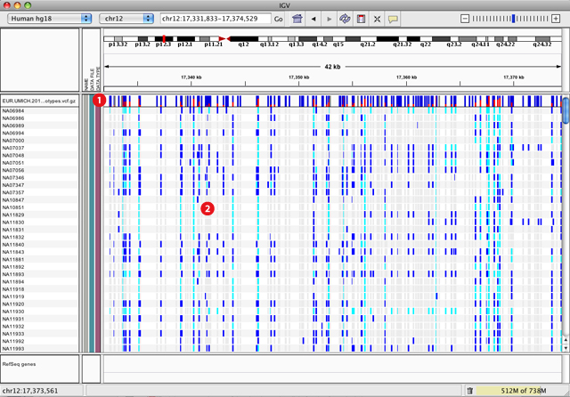
VCFTools - Variant Call Format (VCF)
“VCFtools is a program package designed for working with VCF files,
such as those generated by the 1000 Genomes Project.
The aim of VCFtools is to provide easily accessible methods for working with
complex genetic variation data in the form of VCF files.”

Slide 51
Variant Call Format (VCF) file summarizes variation
VCF header
VCF field definition line and first row of body

Slide 52
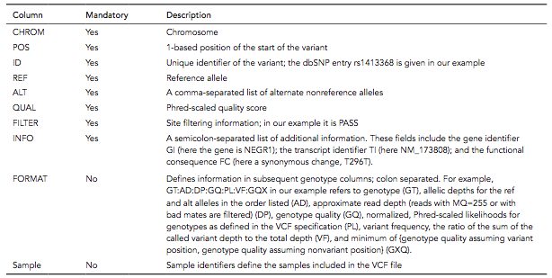
8. Summarizing Variation: the VCF Format and VCFtools
A VCF file includes the following information:

Slide 53
8. Summarizing Variation: the VCF Format and VCFtools
A VCF file includes the following information:
A typical VCF file from a human whole exome sequence experiment may contain ~80,000 rows. A typical human whole genome sequence experiment produces a VCF with ~4 million rows.

Slide 54
Variant Call Format (VCF) file summarizes variation
SNP
Insertion
Deletion
Replacement
Large structural variant
B&FG 3e
Fig.9-17
Page 412

Slide 55
NGS in 11 steps
1. Experimental design and sample preparation
2. From generating sequence Data to FASTQ
3. Genome Assembly
4. Sequence alignment
5. The SAM/BAM format and SAMtools
6. Variant calling: Single nucleotide variants and indels
7. Variant Calling: Structural Variants
8. Summarizing Variation: the VCF Format and VCFtools
9. Visualizing and Tabulating NGS-data
10. Interpreting the biological significance of variants
11. Storing Data in Repositories

Slide 56
9. Visualizing and Tabulating NGS-data
There are many ways to visualize BAM files.
Try Genome Workbench from NCBI
Upload your BAM file to a server and point to it using the UCSC Genome Browser
Use Integrative Genomics Viewer (IGV)
Use samtools tview
We will next explore BEDtools, a set of programs used to analyze BAM, GTF, BED, VCF, and other file types.

Slide 57
BEDtools: a powerful toolset for genome arithmetic
“BEDtools allows one to intersect, merge, count, complement, and shuffle genomic intervals from multiple files in widely-used genomic file formats such as BAM, BED, GFF/GTF, VCF”.
The BED (Browser Extensible Data) format is a text file format used to store genomic regions as
coordinates and associated annotations. (link)
The GFF (General feature format) is a file format used for describing genes and other features of
DNA, RNA and protein sequences. (link)
The VCF (Variant Call Format) is the standard file format for storing variation data. (link)

Slide 58
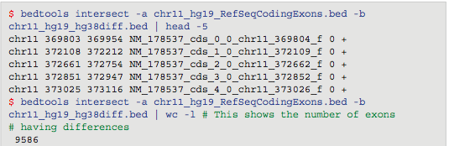
BEDtools example 1: What RefSeq coding exons differ between GRCh37 and GRCh38?
Use BEDtools intersect. General format of a query:
Our query:

Slide 59
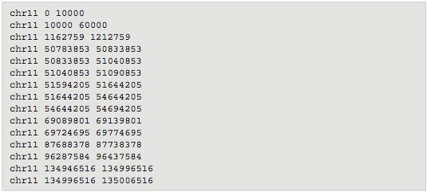
BEDtools example 2: What is the closest chromosomal gap to every RefSeq exon?
Here is a BED file of all gaps on chromosome 11:
Each chromosome has gaps at the telomeres, at the centromere, and at other locations that have been too challenging to sequence.

Slide 60
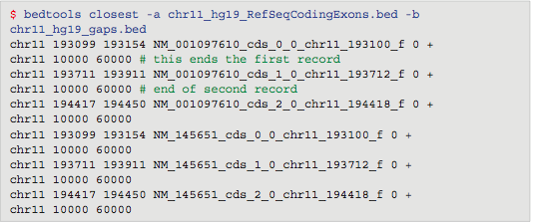
BEDtools example 2: What is the closest chromosomal gap to every RefSeq exon?
We use the bedtools closest utility. Here are the results:

Slide 61
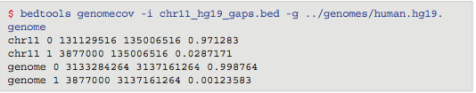
BEDtools example 3: How much of a chromosome (or a genome) is spanned by gaps?
We use the genomecov (genome coverage) utility, and use the -g argument to specify a genome. Here are the results:
2.87% of the chromosome (0.0287), and 0.1% of the genome is spanned by gaps.

Slide 62
NGS in 11 steps
1. Experimental design and sample preparation
2. From generating sequence Data to FASTQ
3. Genome Assembly
4. Sequence alignment
5. The SAM/BAM format and SAMtools
6. Variant calling: Single nucleotide variants and indels
7. Variant Calling: Structural Variants
8. Summarizing Variation: the VCF Format and VCFtools
9. Visualizing and Tabulating NGS-data
10. Interpreting the biological significance of variants
11. Storing Data in Repositories

Slide 63
10. Interpreting the biological significance of variants
This section is organized in two parts.
We will look at software that is used to assess which variants are functionally significant. Over 50 programs have been introduced. We will mention three: SIFT, PolyPhen, and VAAST.
NCBI offers databases, browsers and software tools to understand functionally important variants. We will introduce four NCBI resources.

Slide 64
Neutral versus deleterious variation
For each genome, we can expect to identify ~4 million variants that are exonic, intronic, or intergenic. We first focus on exonic variants. Of these, there are ~11,000 synonymous SNPs (not changing the amino acid specified by the codon; likely to be benign) and ~11,000 nonsynonymous SNPs.
We also consider indels (some of which introduce stop codons), homozygous deletions, splice site mutations, or other changes that may disrupt gene function.

Slide 65
Approaches to distinguish neutral from deleterious nonsynonymous variants
Most DNA is under neutral selection (not under positive or negative selection). Some variants are deleterious. How can we classify 11,000 non-synonymous SNPs in a genome?
Conservation: determine conservation of an amino acid across species
Structure: determine (or predict) effect of a variant on protein structure
True positives: train algorithms on a database of known disease-associated mutations (OMIM)
True negatives: train algorithms of a set of variants in ‘apparently normal’ individuals (1000 Genomes)

Slide 66
Part 1: Software to distinguish neutral from deleterious nonsynonymous variants
PolyPhen2 (Polymorphism Phenotyping v2) is a tool which predicts possible impact of an amino acid substitution on the structure and function of a human protein using straightforward physical and comparative considerations.
http://genetics.bwh.harvard.edu/pph2/
SIFT predicts whether an amino acid substitution affects protein function based on sequence homology and the physical properties of amino acids.
http://sift.jcvi.org/

Slide 67
VAAST: probabilistic tool for disease variants
VAAST (Variant Annotation, Analysis & Search Tool) is a probabilistic search tool used to identify disease-causing variants.
VAAST calculates amino acid substitution frequencies for healthy genomes and disease genomes (both of these differ from standard BLOSUM62).

Slide 68
NGS in 11 steps
1. Experimental design and sample preparation
2. From generating sequence Data to FASTQ
3. Genome Assembly
4. Sequence alignment
5. The SAM/BAM format and SAMtools
6. Variant calling: Single nucleotide variants and indels
7. Variant Calling: Structural Variants
8. Summarizing Variation: the VCF Format and VCFtools
9. Visualizing and Tabulating NGS-data
10. Interpreting the biological significance of variants
11. Storing Data in Repositories

Slide 69
11. Storing Data in Repositories
There are 4 main storing techniques/ methods
Local server
Public databases such as:
European Bioinformatics Institute (EBI)
Gene Expression Omnibus (GEO)
Sequence Read Archive (SRA)
The Cancer Genome Atlas (TCGA)
National Heart Blood Lung Institute (NHLBI)
Exome Aggregation Consortium (ExAC)
Cloud computing (Amazon, Google)
Trashcan

Slide 70
Specialized next-generation sequence (NGS) applications
There are many useful applications of NGS technology. These include:
RNA-seq (Chapter 11) to measure RNA levels (“gene expression” of genes and isoforms)
Chromatin immunoprecipitation sequencing (ChIP-Seq) to measure protein– DNA interactions
Methyl-seq
FAIRE-seq
many others

Slide 71
Perspective
Next-generation sequencing (NGS) technology is revolutionizing biology. We are now able to catalog genetic variation at unprecedented depth.
There is rapid growth in the technologies used for NGS. There are also vast numbers of software solutions for quality control, sequence alignment, genome assembly, variant calling (including single nucleotide variants, indels, and structural variants), and variant prioritization.
Key file formats include FASTQ (“raw” reads), BAM/SAM (aligned reads), and VCF (variant calls). Many tools are available for the generation, analysis, and visualization of these types of files.

